Slide 1

Knowledge Graphs And AI based Search
“Defenders think in lists. Attackers think in graphs. As long as this is true, attackers win.”
- John Lambert, Microsoft

Slide 2
Agenda
The Search Evolution Story
Knowledge Graphs??
AI Powered Search
GraphRAG & Demos

Slide 3


Slide 4
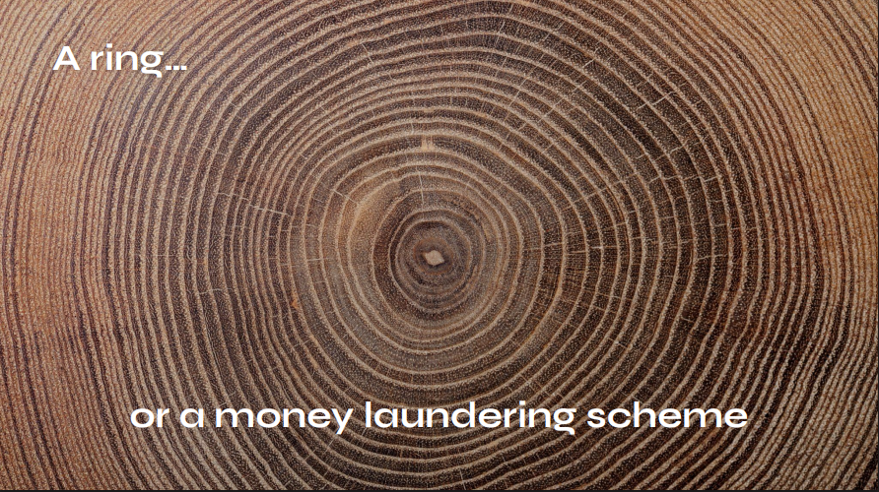

Slide 5


Slide 6
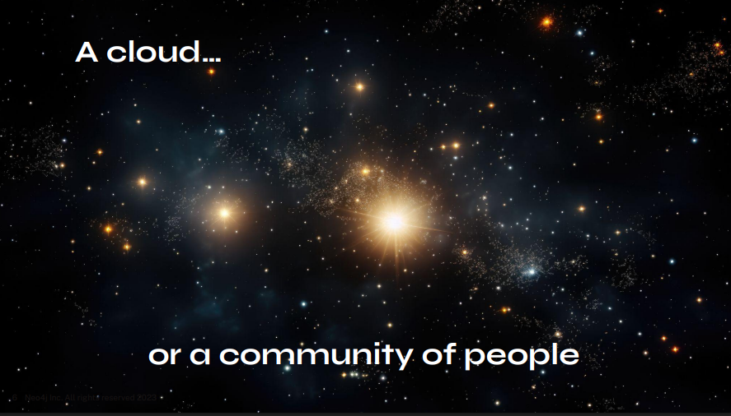

Slide 7
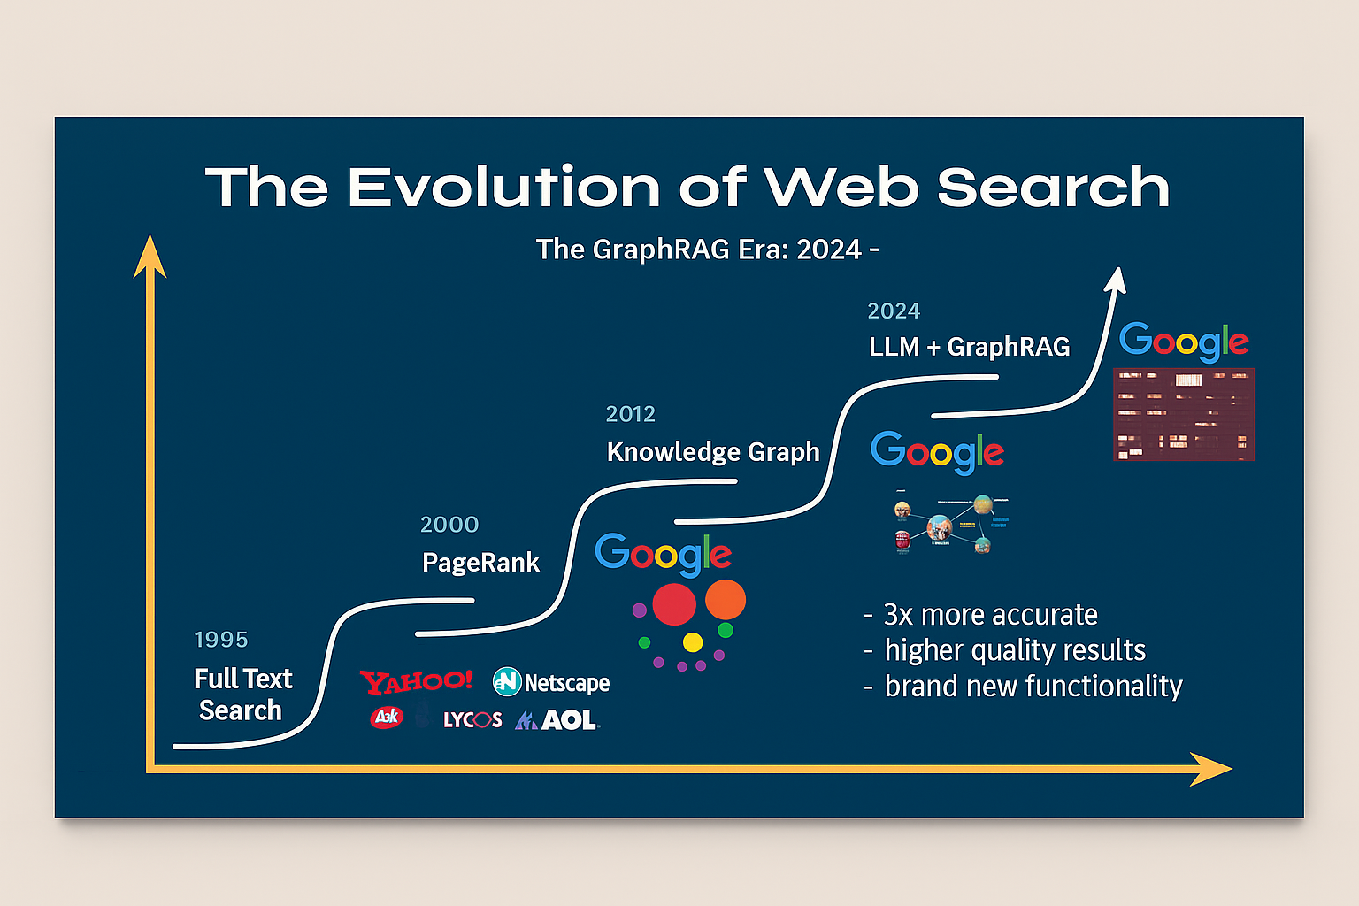

Slide 8


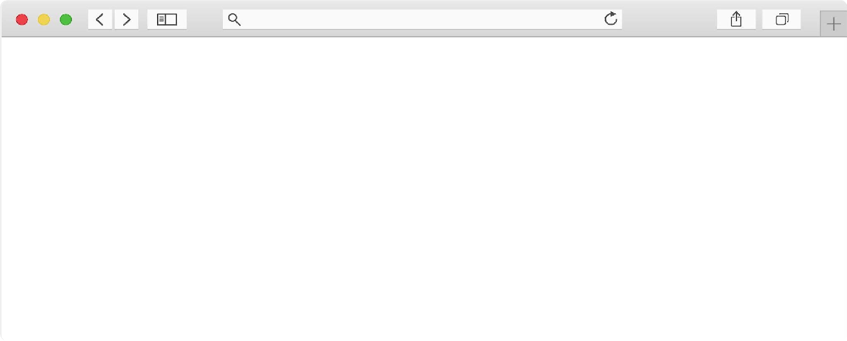

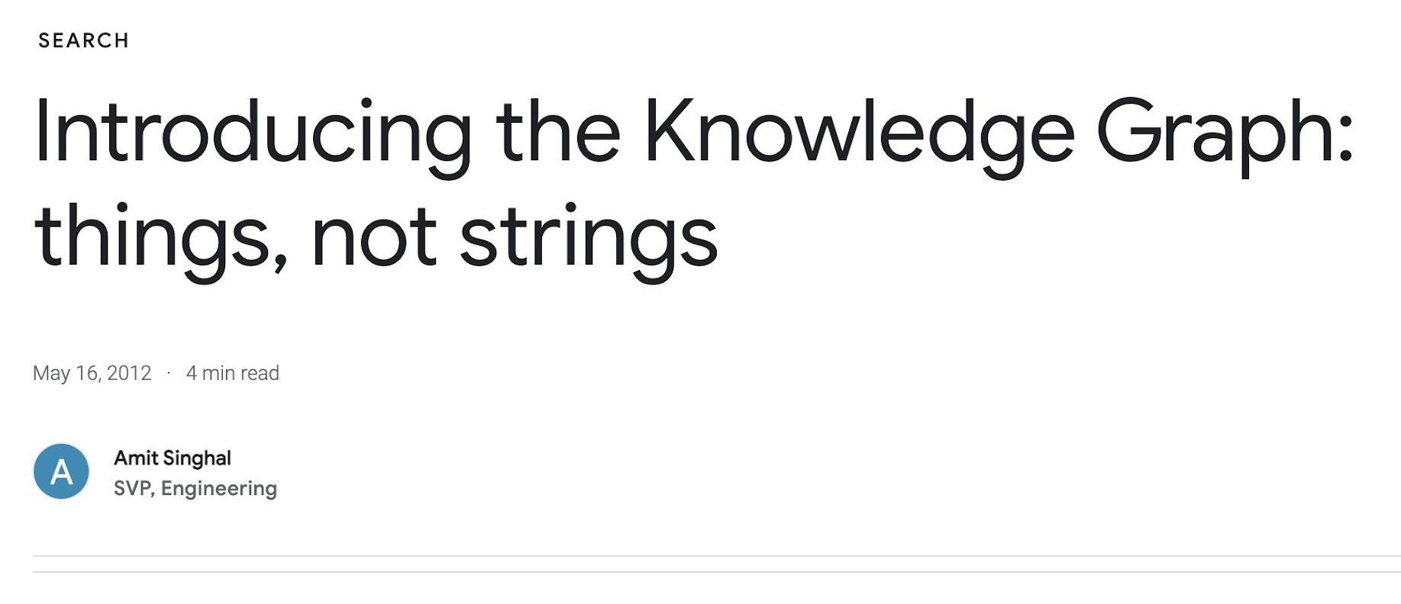
https://blog.google/products/search/introducing-knowledge-graph-things-not/

Slide 9
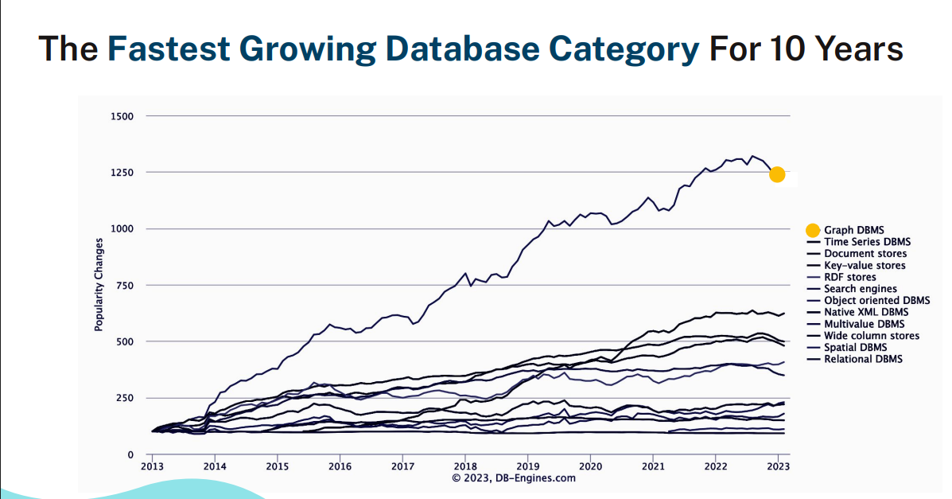

Slide 10
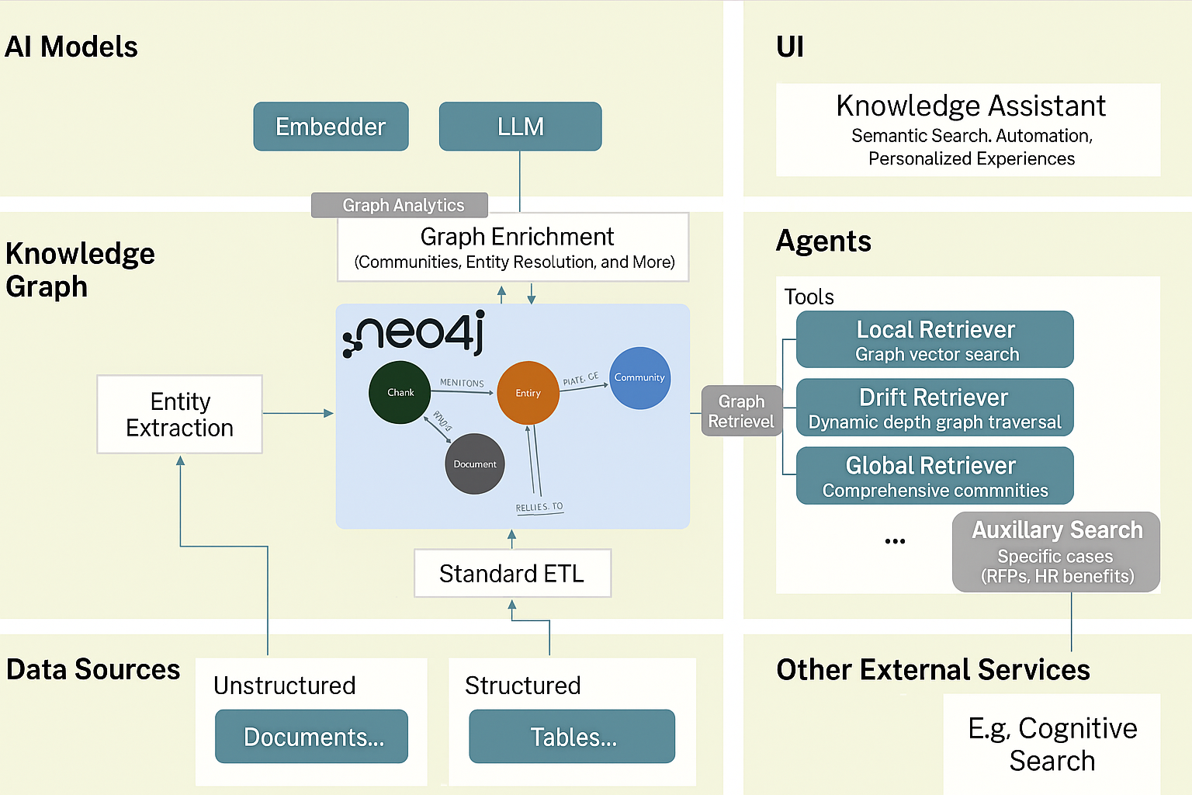

Slide 11

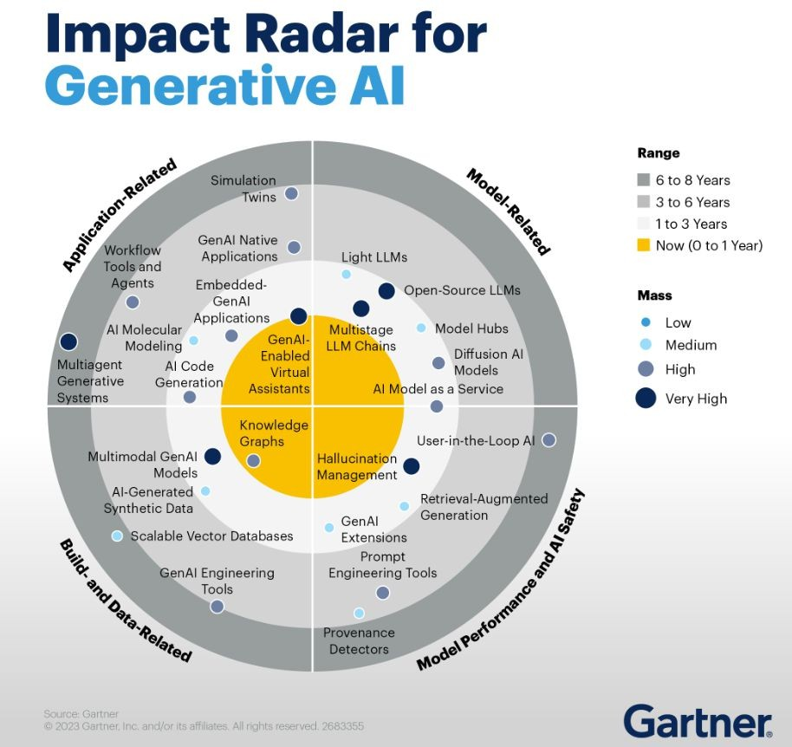
https://www.gartner.com/en/articles/understand-and-exploit-gen-ai-with-gartner-s-new-impact-radar

Slide 12
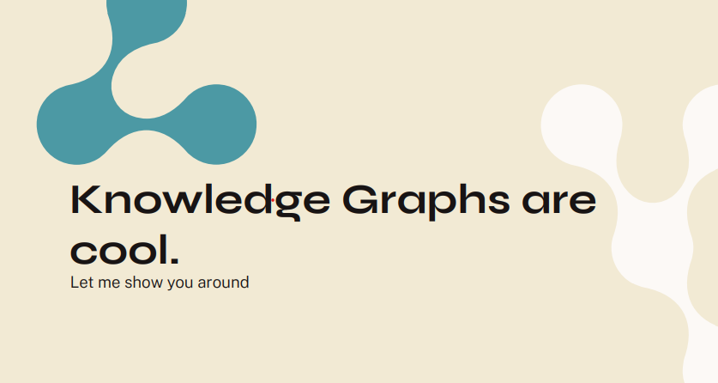

Slide 13


Slide 14


Slide 15
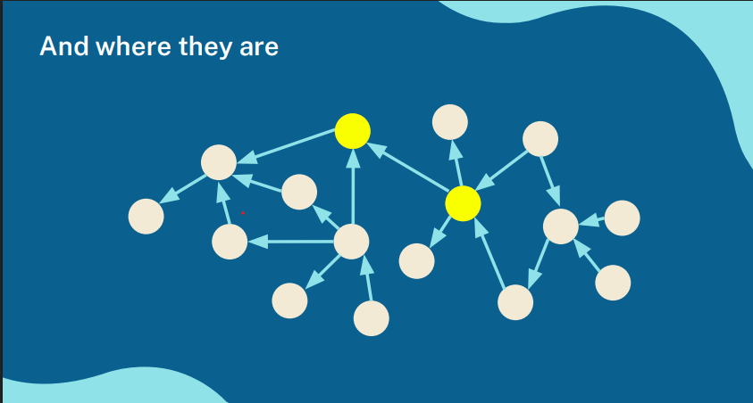

Slide 16
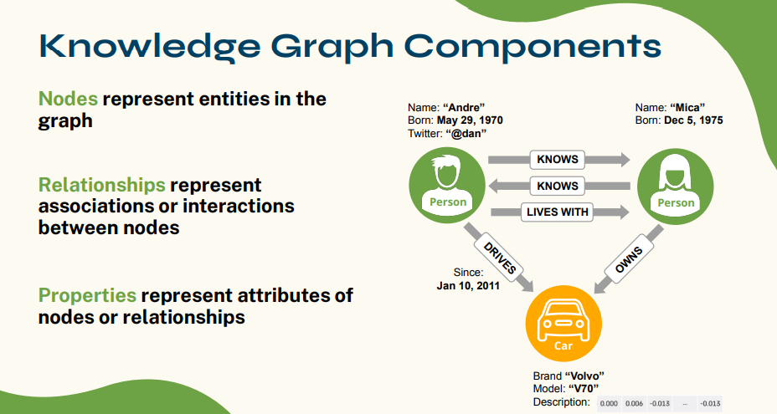

Slide 17
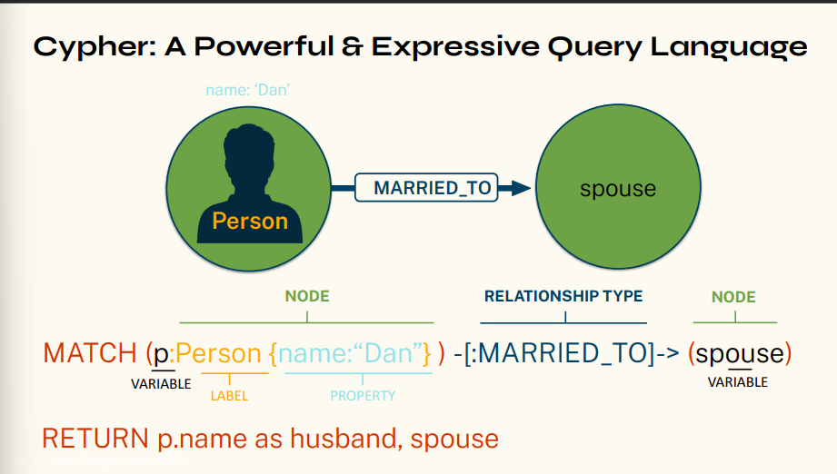

Slide 18
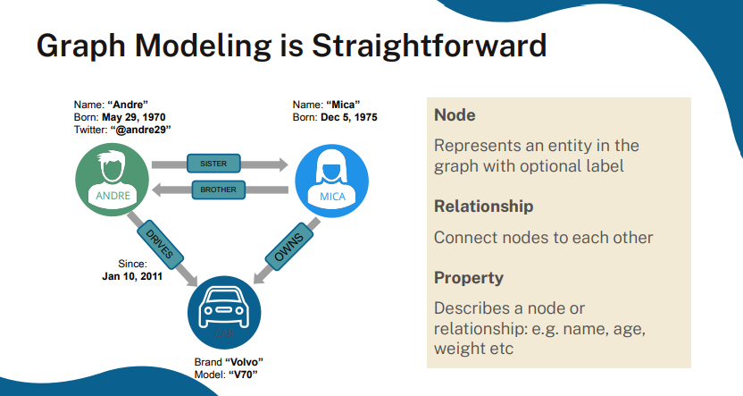

Slide 19
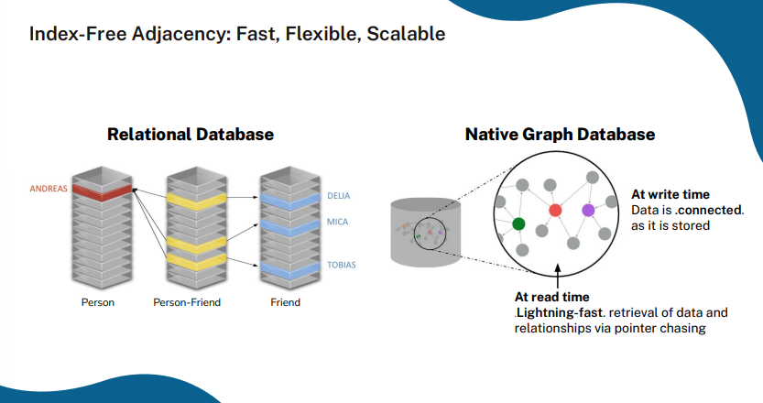

Slide 20
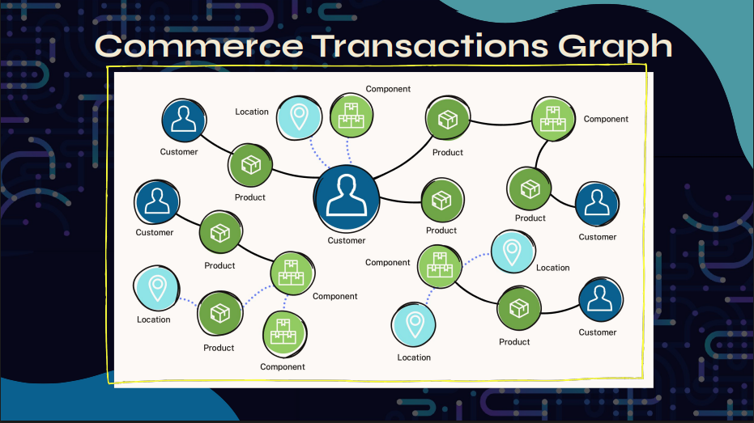

Slide 21
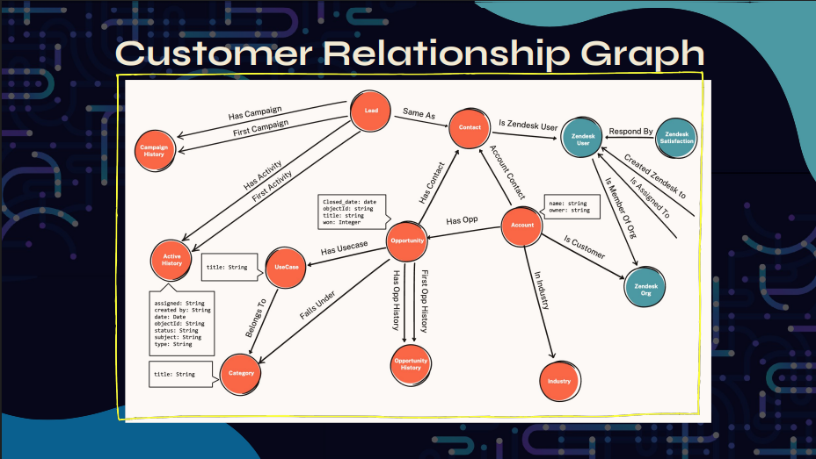

Slide 22
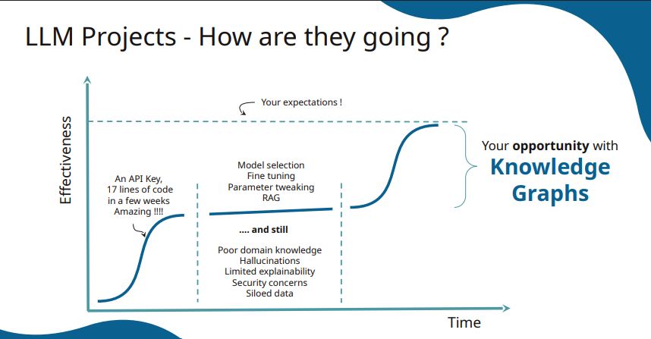

Slide 23
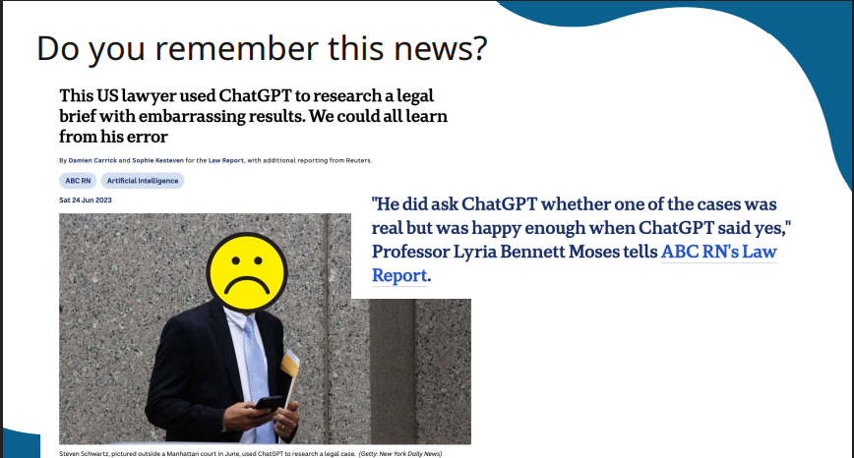

Slide 24
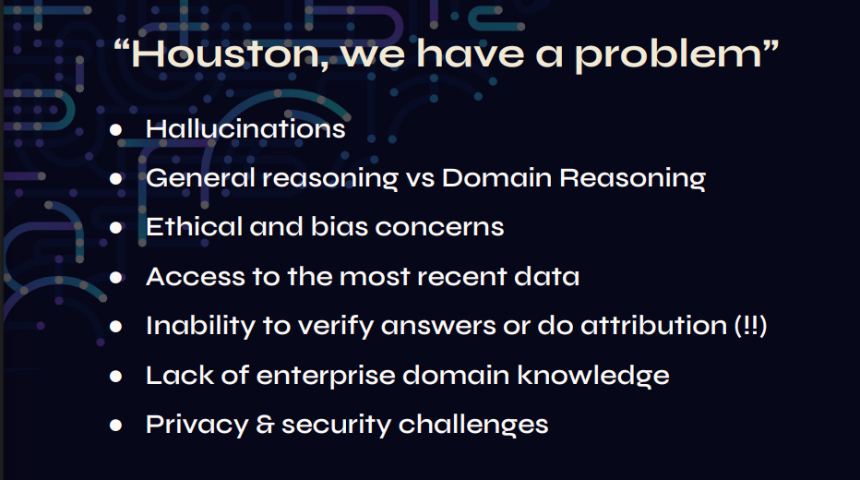

Slide 25
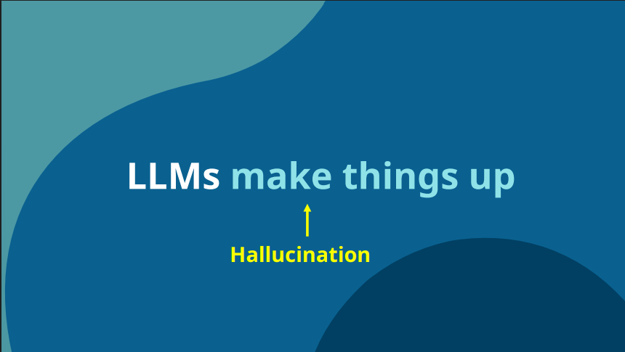

Slide 26
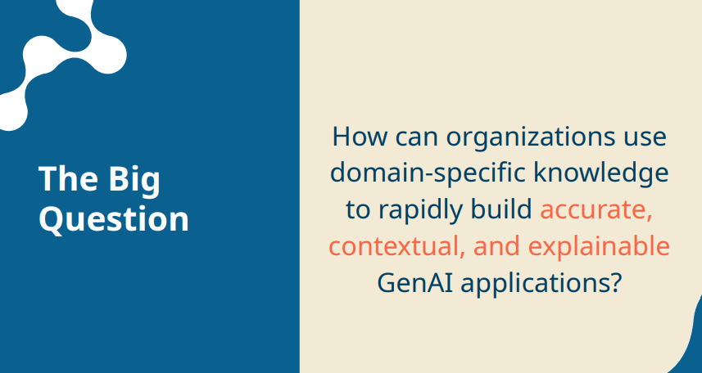

Slide 27
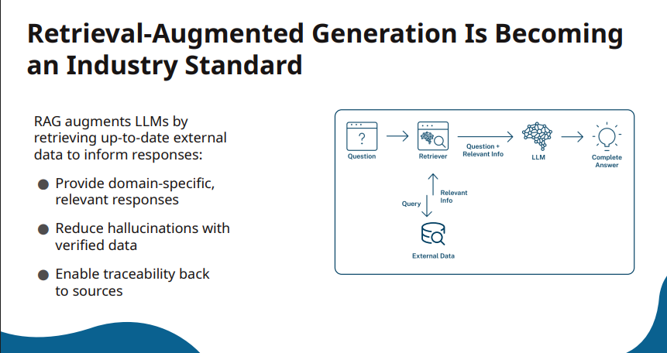

Slide 28
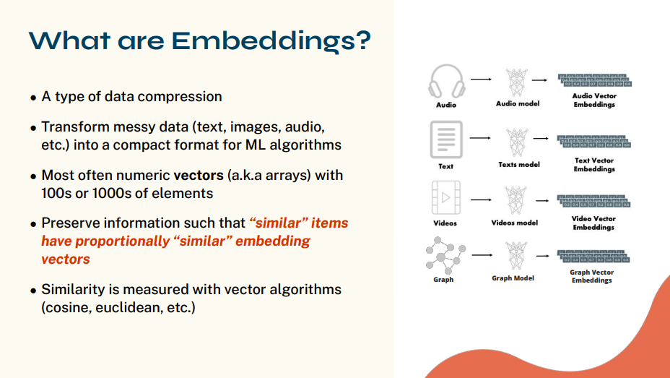

Slide 29
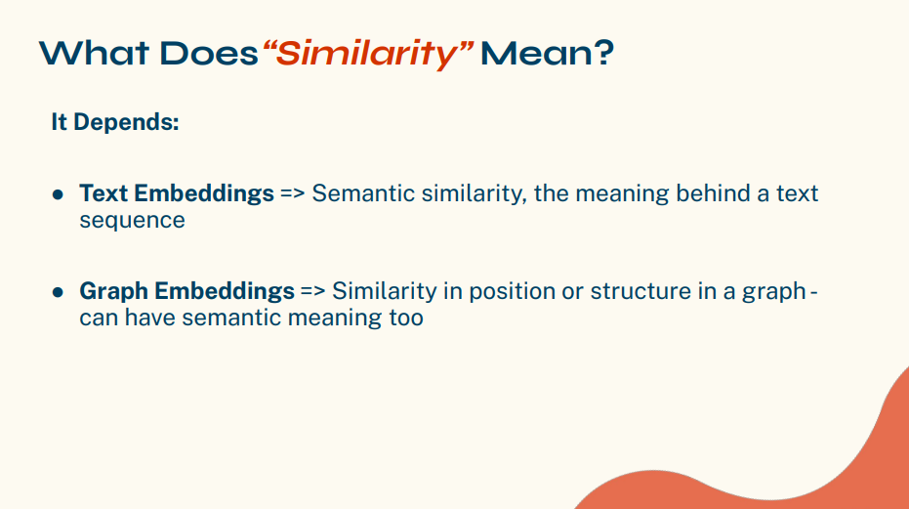

Slide 30
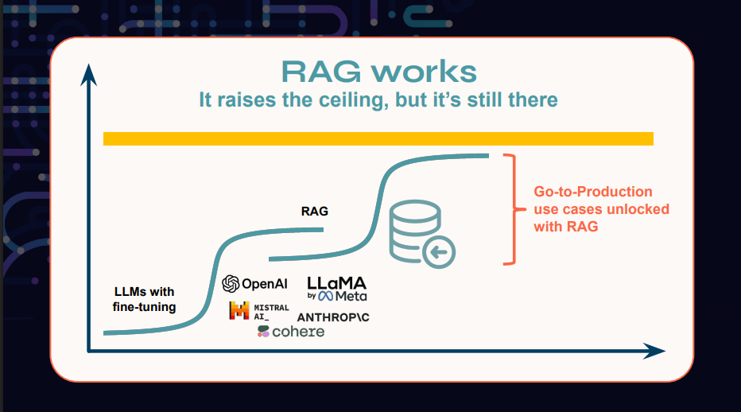

Slide 31
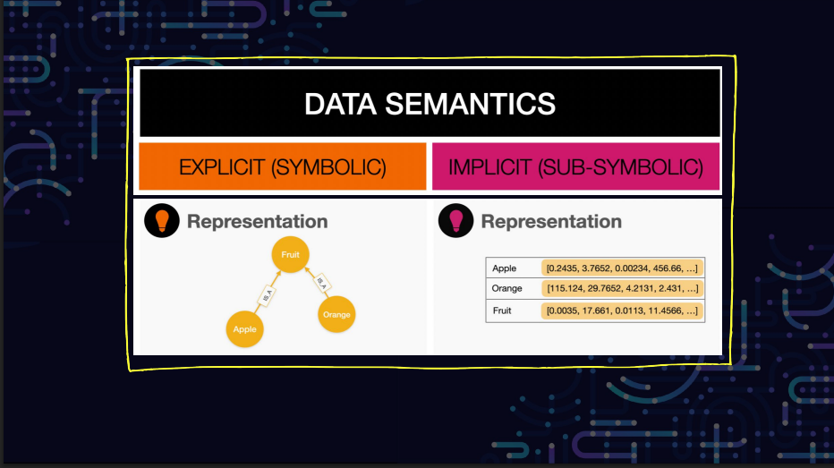

Slide 32
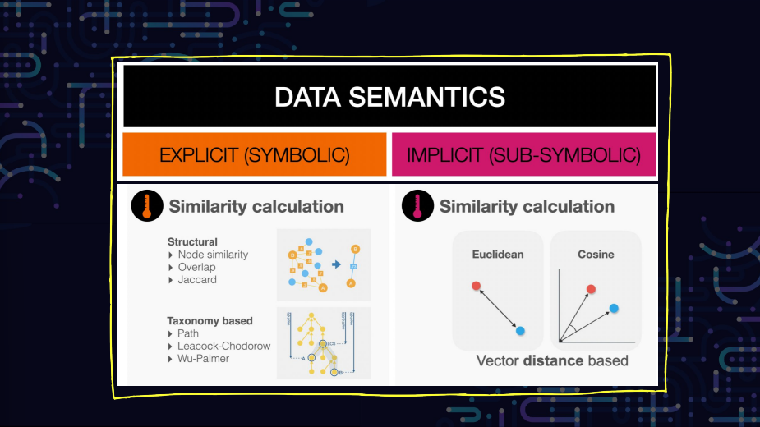

Slide 33
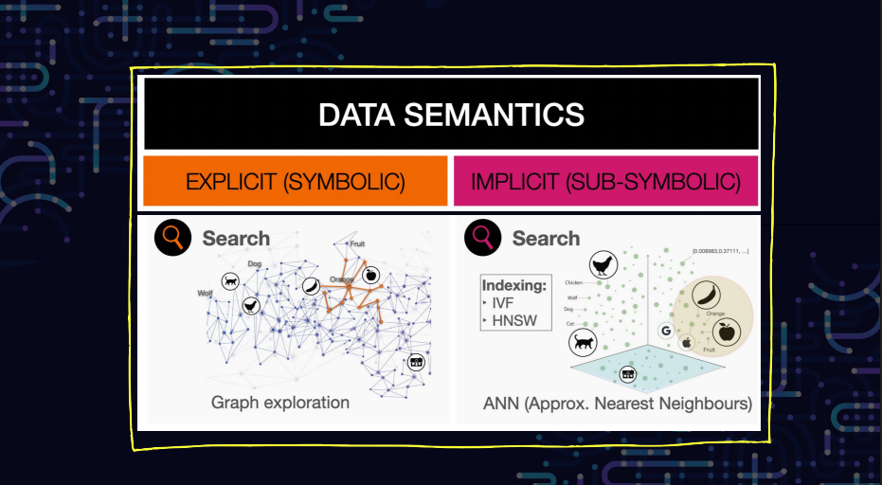

Slide 34
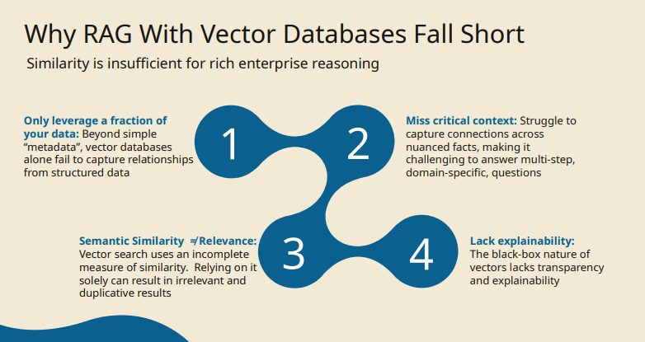

Slide 35
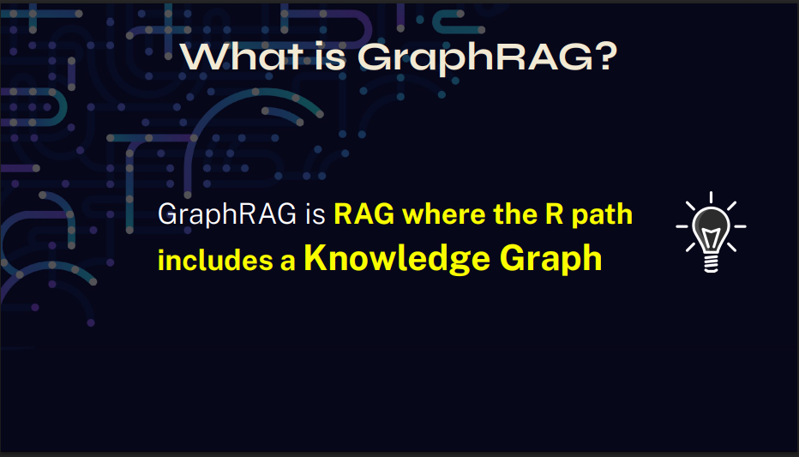

Slide 36
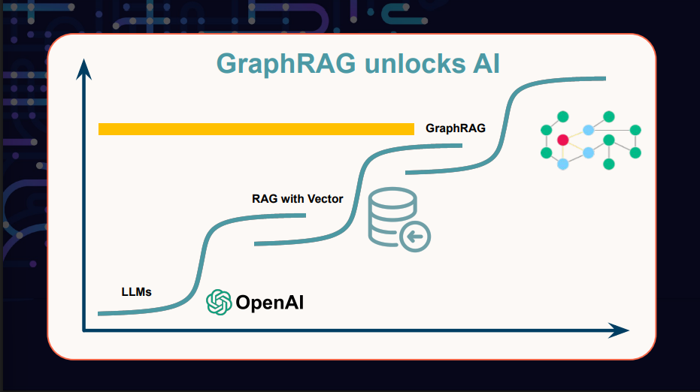

Slide 37
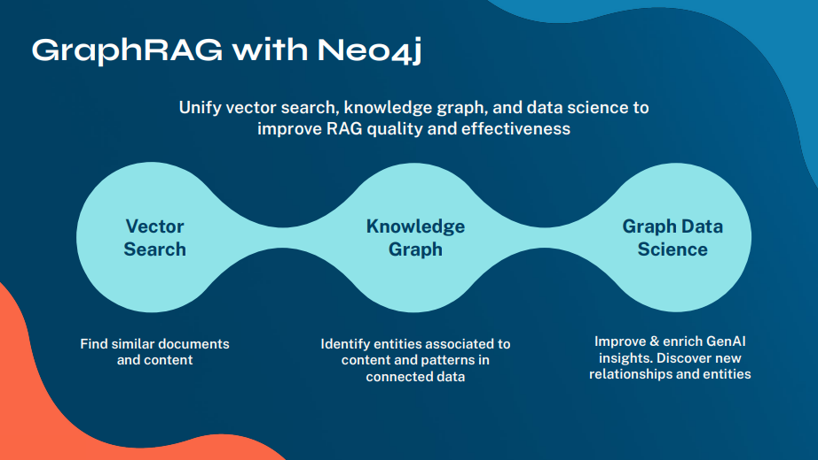

Slide 38
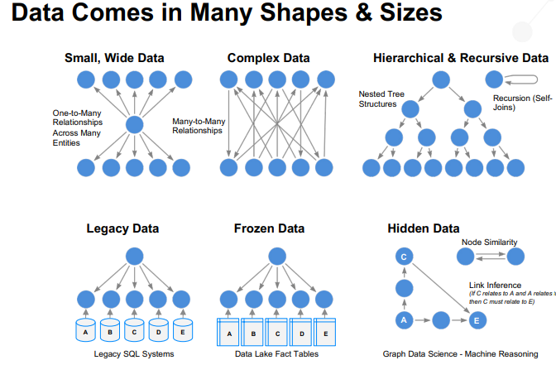

Slide 39
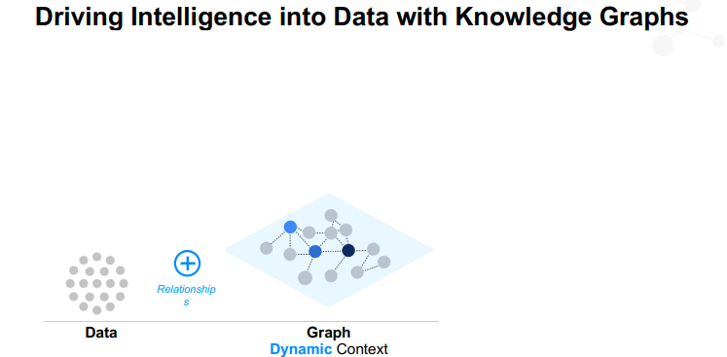

Slide 40
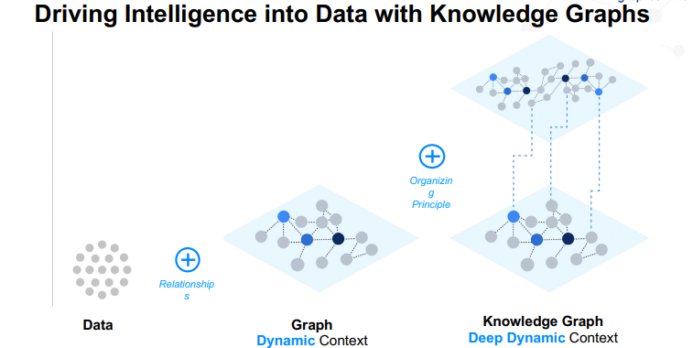

Slide 41
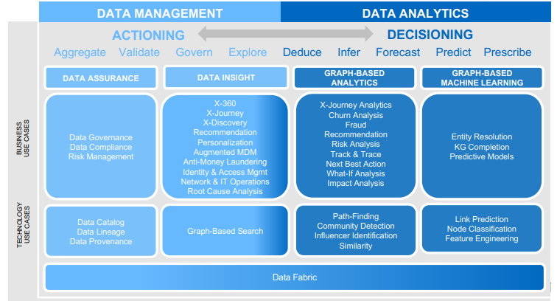

Slide 42
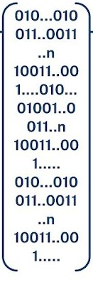

Accurate, Contextual and Explainable
User Question
Embedding
Model
GenAI App
Who is the AWS Manager of ABC ?

Slide 43
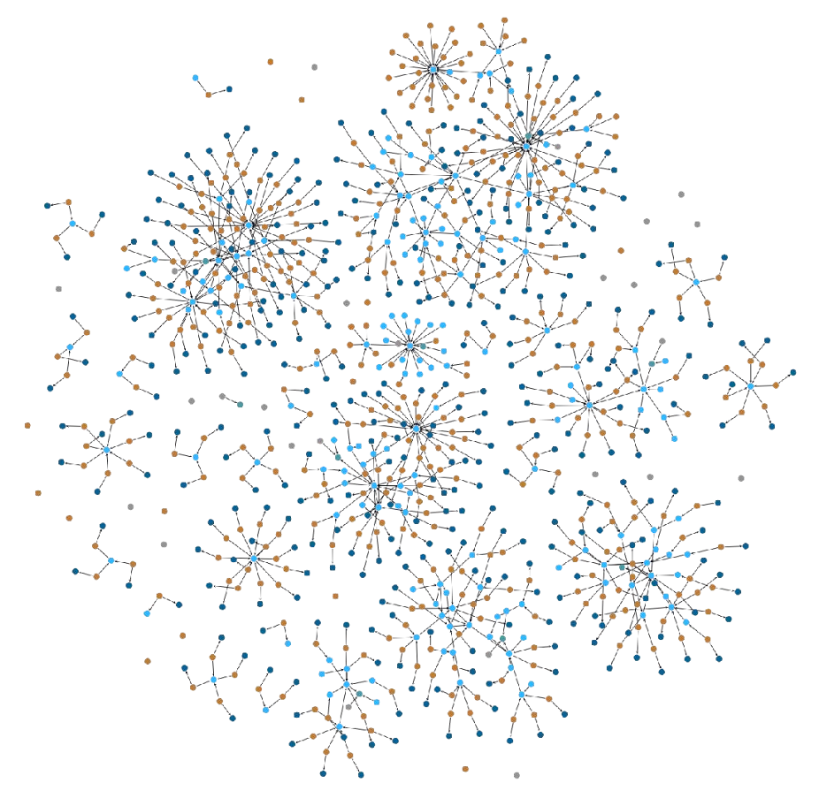
Accurate, Contextual and Explainable
User Question
Vector Embedding
Embedding
Model
GenAI App
Who is the AWS Manager of ABC ?

Slide 44
Accurate, Contextual and Explainable
User Question
Vector Embedding
Embedding
Model
GenAI App
Similarity Search using
Neo4j Vector Index
Who is the AWS Manager of ABC ?

Slide 45
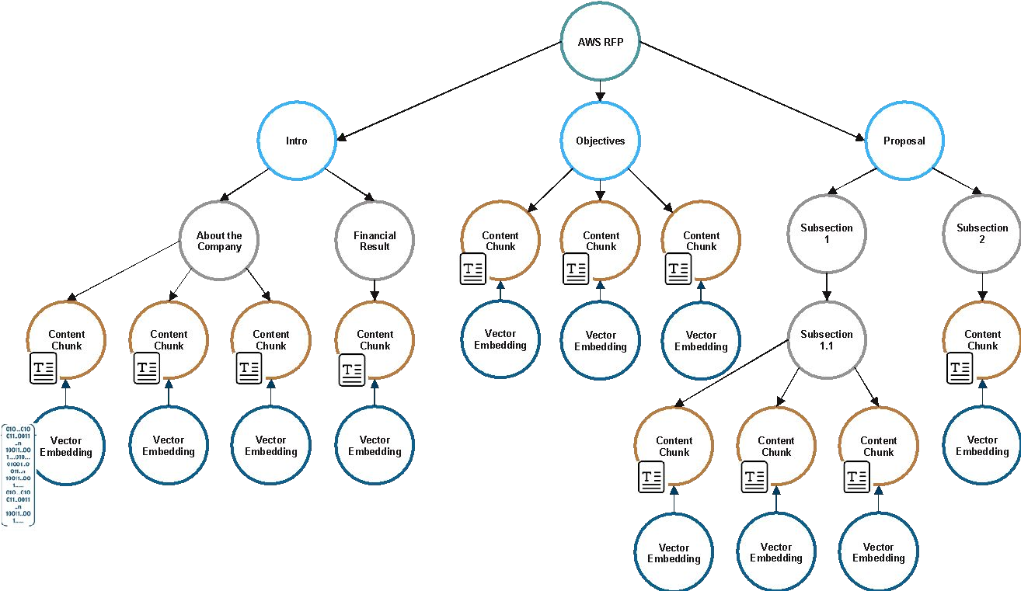
Accurate, Contextual and Explainable
Similarity Search using
Neo4j Vector Index
Response from ABC Company
Signed by John Smith
He’s the General Manager

Slide 46
Accurate, Contextual and Explainable
Contextual Knowledge Retrieval within Neo4j KG
Response from ABC Company
Signed by John Smith
He’s the General Manager

Slide 47
Accurate, Contextual and Explainable
Knowledge Retrieval to aid in Explainability
Response from ABC Company
Signed by John Smith
He’s the General Manager

Slide 48

Accurate, Contextual and Explainable
Fine Grained Access Control to prevent unwarranted Knowledge Retrieval
Response from ABC Company
Signed by John Smith
He’s the General Manager

Slide 49
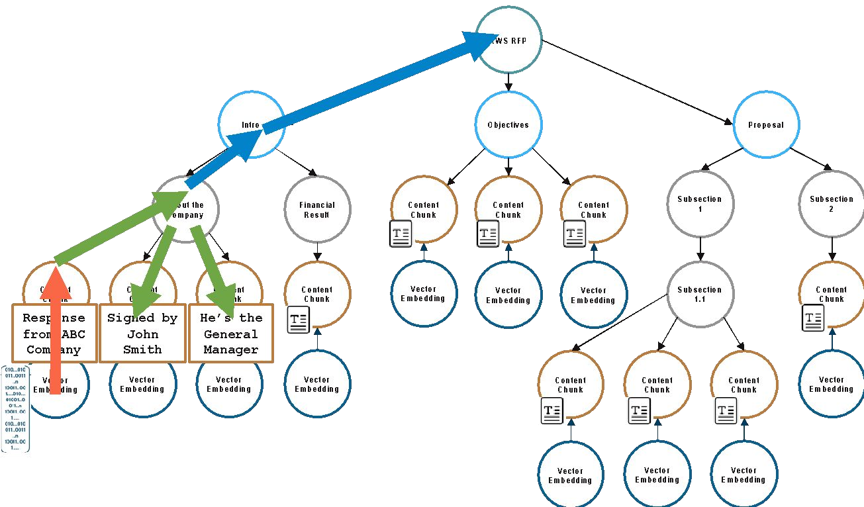
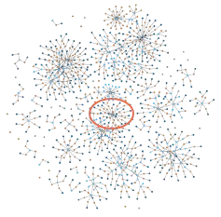
Accurate, Contextual and Explainable
Similarity Result
Bedrock
LLM
User Question
Vector Embedding
Embedding
Model
GenAI App
Similarity Search using Neo4j Vector Index
Who is the AWS Manager of ABC ?
Neo4j Inc. All rights reserved 2025

Slide 50
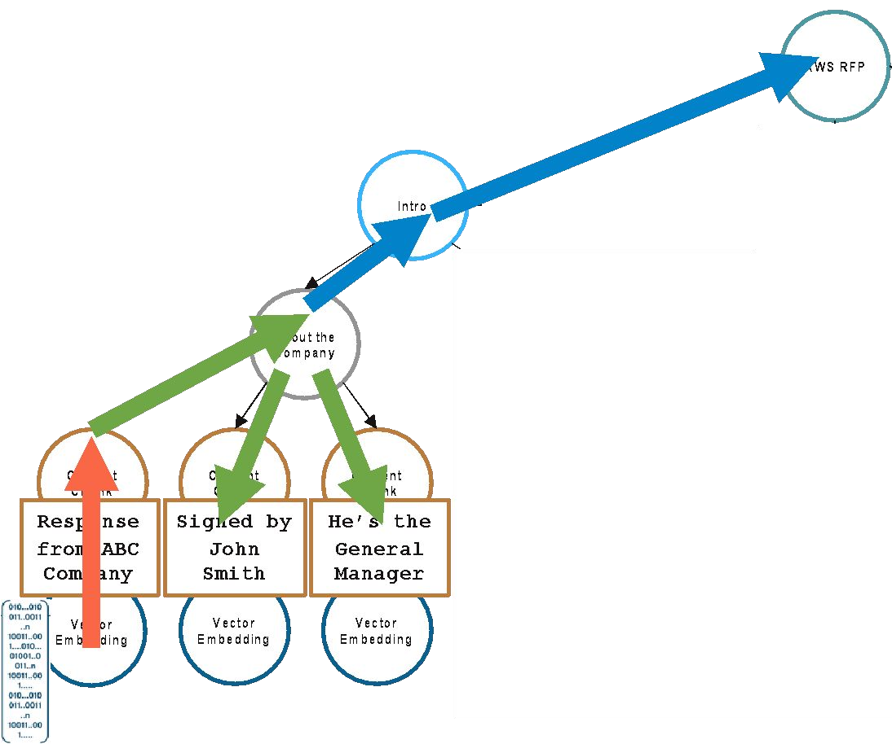
Accurate, Contextual and Explainable
Similarity + Contextual Result
The main respondent AWS RFP AWS is John Smith, General Manager XYZ Group representing ABC Company (source: AWS.pdf, page: 38)
Similarity Result
Bedrock
LLM
User Question
Vector Embedding
Embedding
Model
GenAI App
Similarity Search using Neo4j Vector Index
Who is the AWS Manager of ABC ?

